Slide 1
Principles of the Software Design
Course for Armenian-French University
Areg Melik-Adamyan
Petr Kurapov

Slide 2
Lecture 2
Concepts and Starting Decomposition
Language of the Design

Slide 3
Agenda
Complexity definition
Working code is not enough
Deep vs Shallow modules

Slide 4
Requirements and Design
Requirements
Requirements
NOT
Design
Design

Slide 5
Agenda and Questions
Why are we doing the project? Stakeholder Analysis
What must we achieve? Requirements Definition
How could we do it? Starting Design.
Oftentimes, there are many different ways!

Slide 6
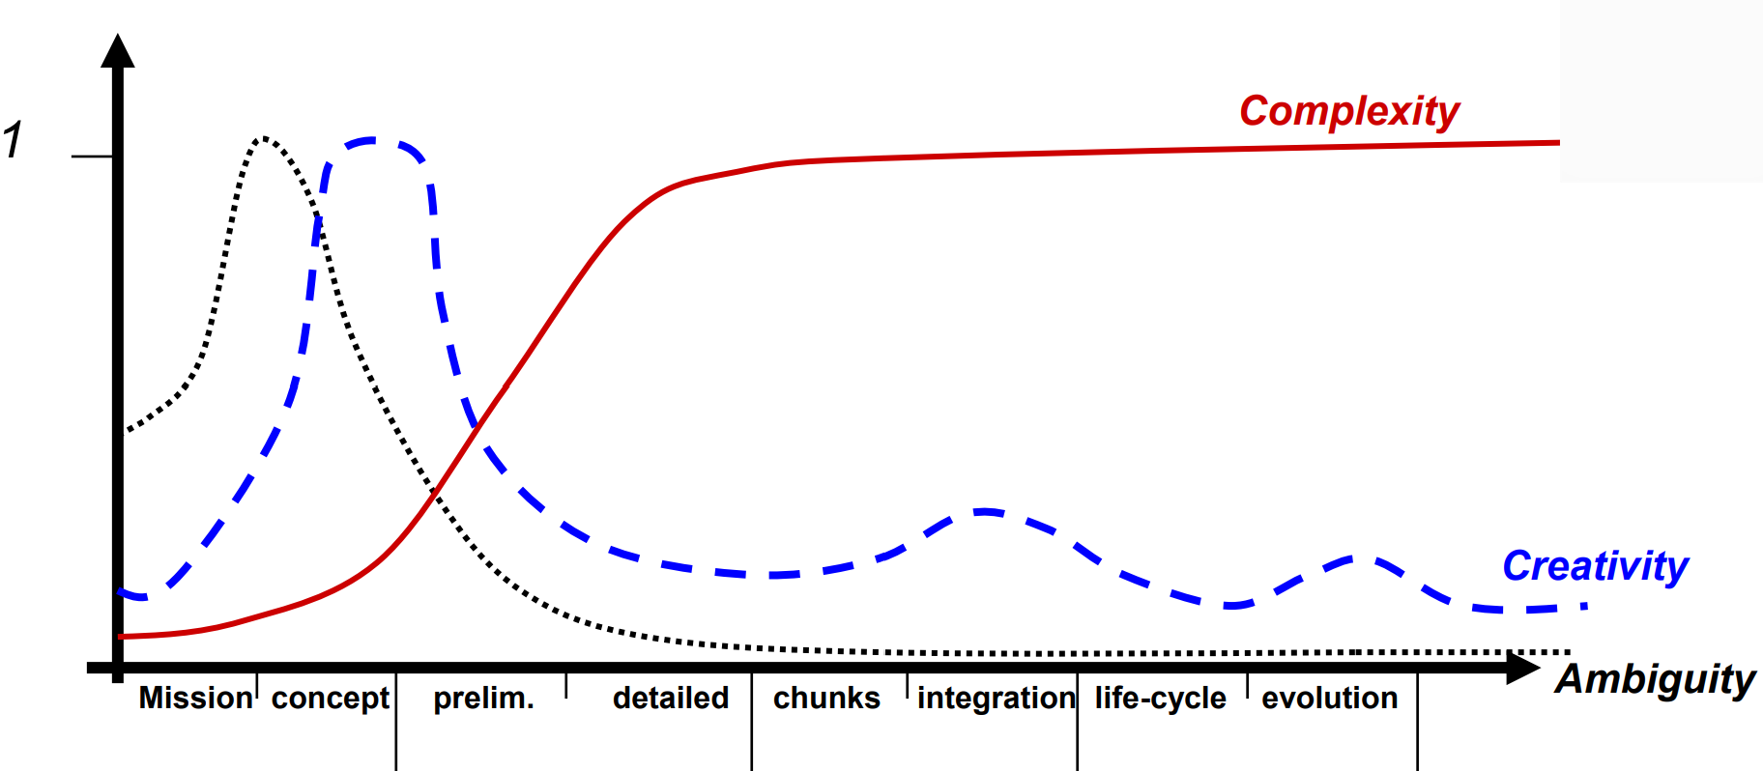
Systems Engineering Phases
NASA definition
Early on ambiguity is high → reduce ambiguity → requirements
Concepts are needed → focus creativity → concepts
Complexity starts increasing → manage complexity → designs

Slide 7
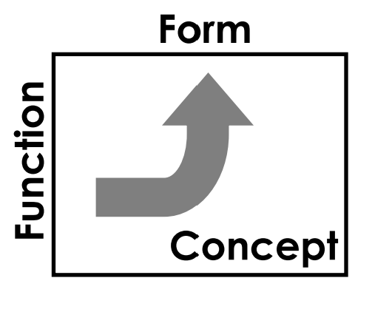
A Definition
Architecture
The embodiment of concept, and the allocation of physical/informational function (process) to elements of form (objects) and definition of structural interfaces among the objects
Consists of:
Function
Related by Concept
To Form

Slide 8
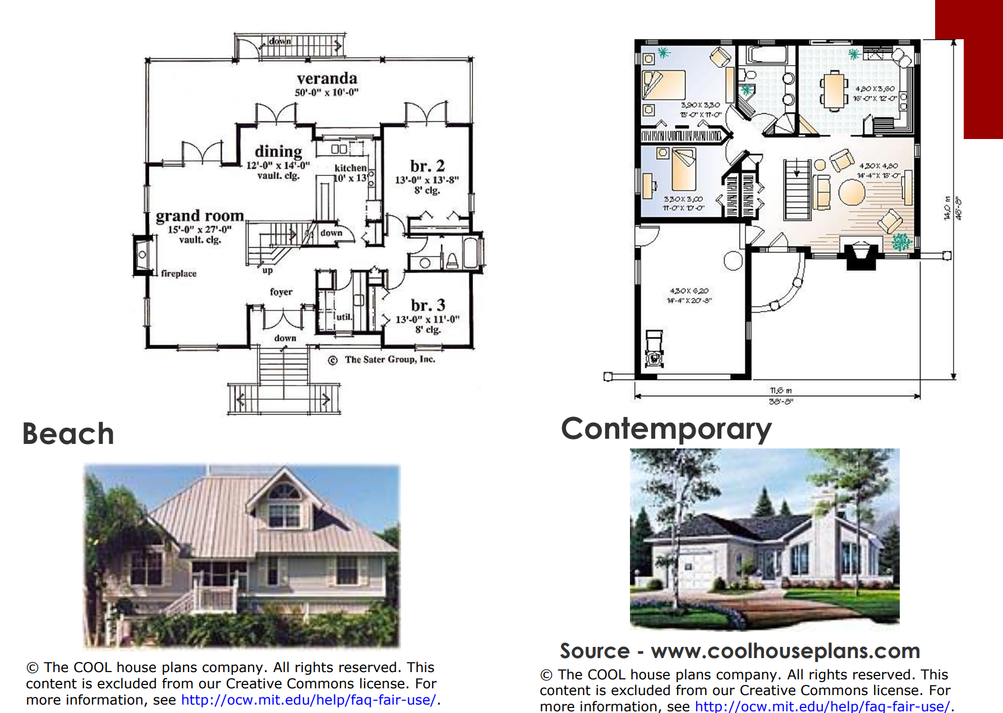
Architecture - Civil

Slide 9
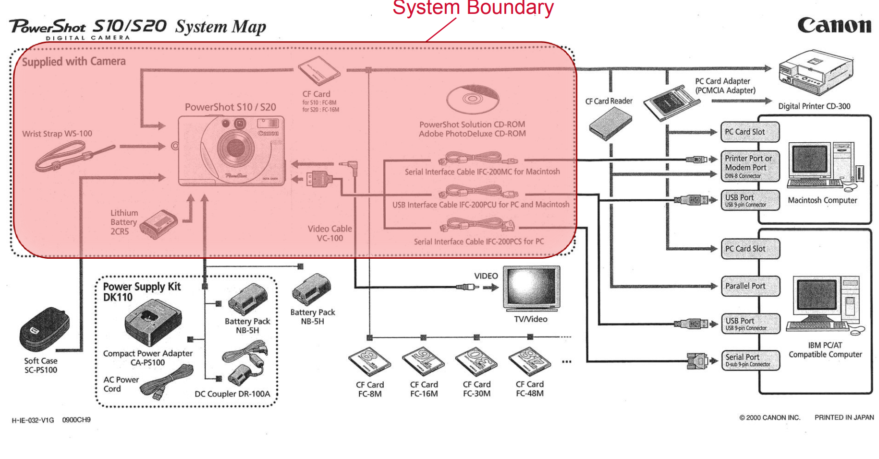
Architecture - Informational

Slide 10
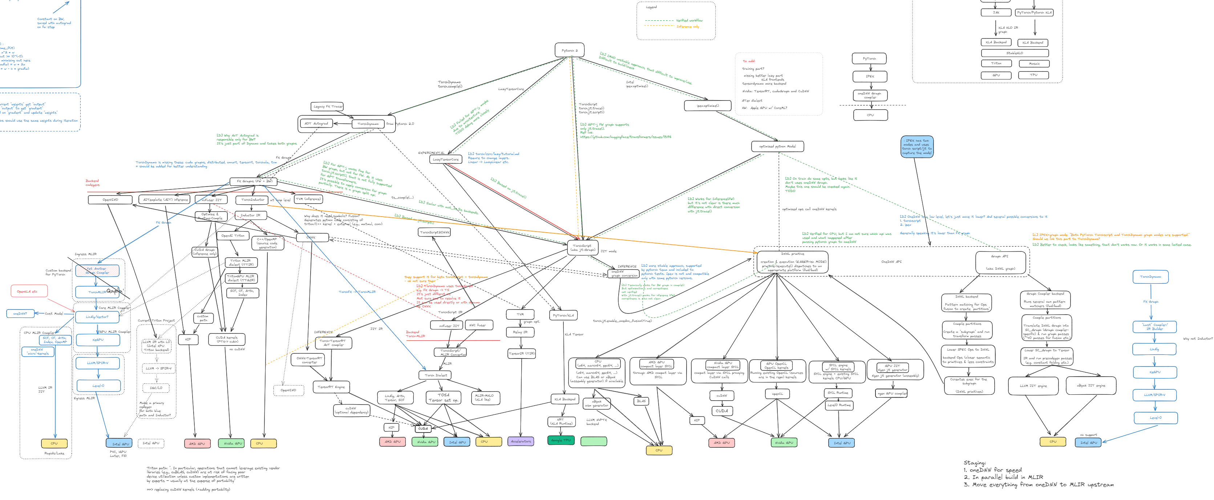
Architecture – Software

Slide 11
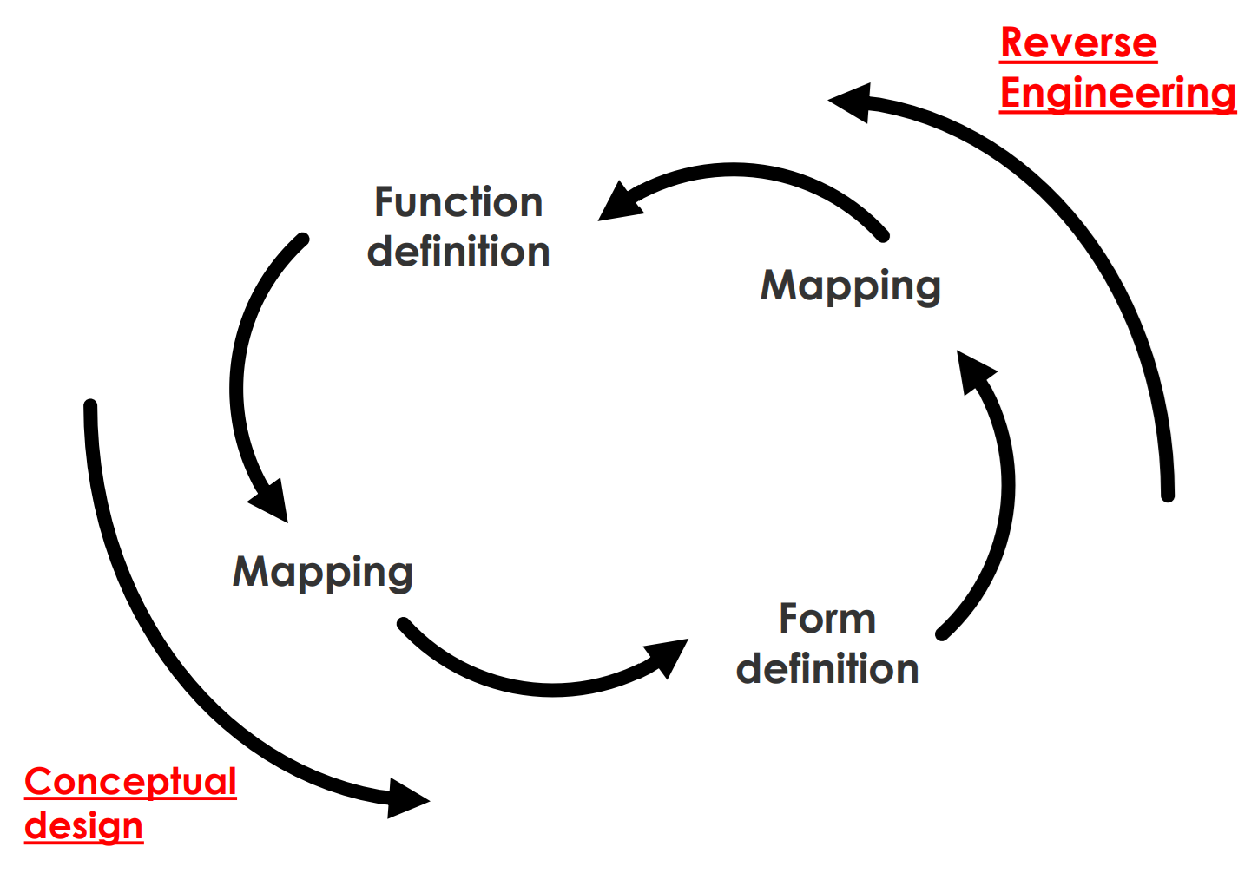
Design Sequence
In design, you know the functions you want and try to create the form to deliver the function(s)
In Design (naïve approach)
Define externally delivered function, create concept, break down functions (“functional decomposition”), define subsystems

Slide 12
Concept
Is created by the architect
Must allow for an execution of all functions
Establishes the solution vocabulary
Implicitly represents a technology

Slide 13
Concept – Informal Definition
A product or system vision, idea, notion or mental image which:
Maps Form to Function
Embodies “Working Principles”
Is in the solution-specific vocabulary - it is the solution
Is an abstraction of form
Is not a product/system attribute, but a mapping

Slide 14
Expressing Concept
New Concepts are expressed by a few words or a short phrase (e.g. refrigerator = insulated box containing mechanically chilled air)
Established concepts can often be expressed by a word or two (sometimes the common name of the form associated with the concept) or an icon
Once the concept is specified, the nature and list of parts are more or less established
Concepts, like form, are expressed as nouns, but concepts tend to be more abstract, while form is actually implemented
What is the key concept of some of the products that you use?

Slide 15
Concept - Formal Definition
The specialization of function and mapping to its physical/informational embodiment of form
The specification of the list of the design variables, which when specified will define the design
Products based on the same concept are “continuously connected”
Typically, products in a family are based on the same concept

Slide 16
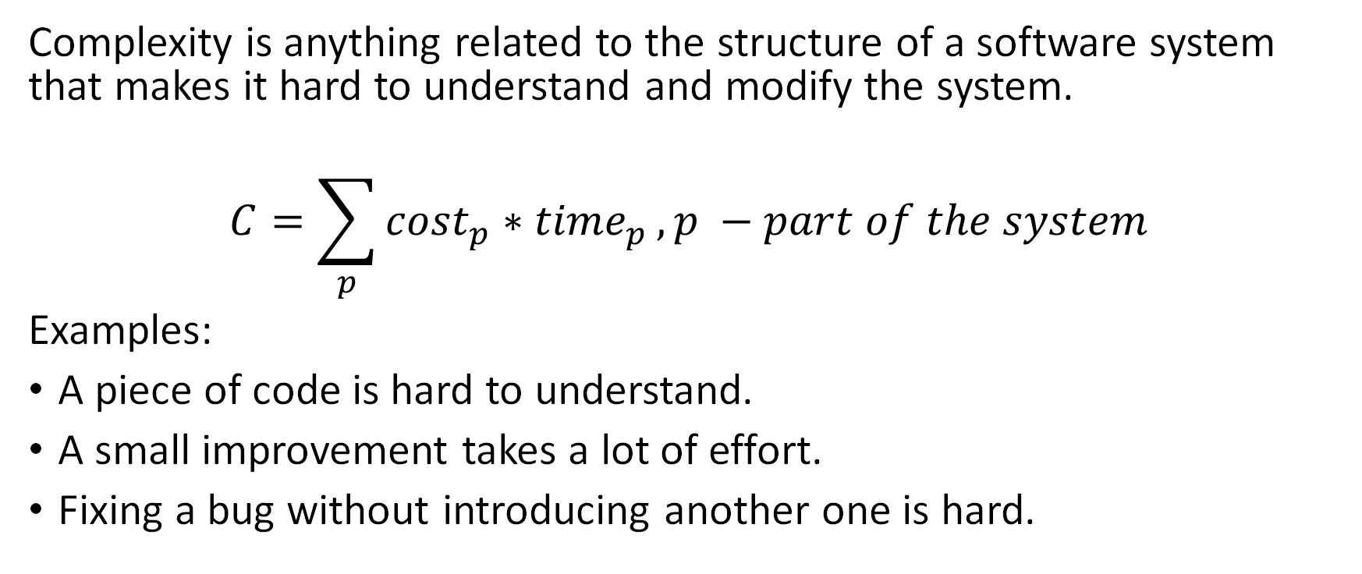
Complexity definition
Complexity is anything related to the structure of a software system that makes it hard to understand and modify the system.
$$C=\sum_{p}{{cost}_{p}∗{time}_{p}}, p −part of the system$$
Examples:
A piece of code is hard to understand.
A small improvement takes a lot of effort.
Fixing a bug without introducing another one is hard.

Slide 17
Symptoms of complexity (remove)
Change amplification
Example (#ifdef CUDA!!)
Cognitive load
Example (global variables, module dependencies – data mgr in hdk)
Lines of code is not a good measure!!
Unknown unknowns – something you need to know, but there’s no way of finding out what it is
Example (smth like a lack of dependency on a global-ish setting; options!! Update of the option by some rule that’s not apparent)

Slide 18
Causes of complexity (remove)
Dependencies – a piece of code cannot be understood or modified in isolation.
Example 1: method signature.
Example 2: serialization & deserialization.
Obscurity – important information is not obvious.
Example 1: variable name (time) or inadequate documentation.
Example 2: Error status & messages.
Complexity is incremental: thousands of small dependencies and obscurities introduced by current changes

Slide 19
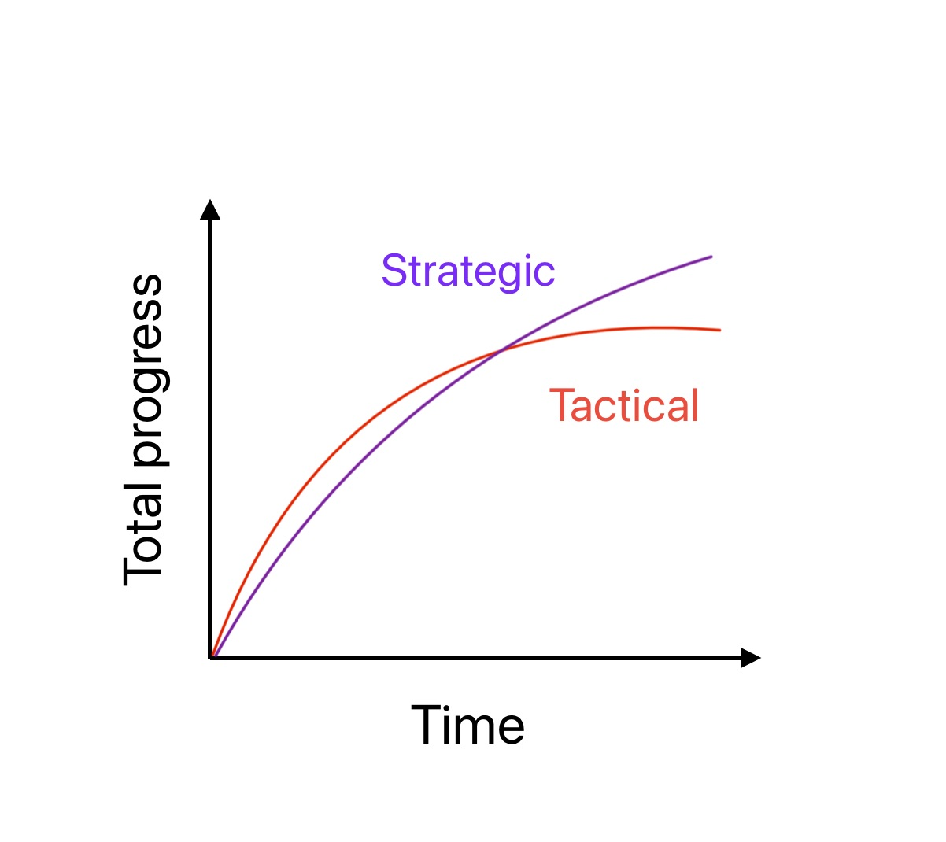
Working code is not enough
Tactical vs Strategic programming
Your primary goal is to produce a good design.
Good design doesn’t come for free – it has to be something invested in continuously.
Technical debt as a consequence of tactical programming

Slide 20
Modules should be deep
Modular design – only a fraction of the overall complexity faces a user of a given module (classes, subsystems, services, etc.).
Ideal scenario: modules are completely independent. The goal of the design is to minimize the dependencies between modules.
Modules consist of interfaces (the “what”) and implementations (the “how”).
Developers should not need to understand the implementation of a module that they are not working on directly.

Slide 21
Interfaces & Abstractions
Anything a user must know to interact with a module is a part of the interface.
Two kinds of information
Formal: explicit information in code (e.g., number & type of arguments). These can typically be checked by the programming language.
Informal: constraints, assumptions, or high-level behavior (e.g., methods calling order, system state changes like file creation). These usually reside in the comments and cannot be automatically checked.
An abstraction is a simplified view of an entity, which omits unimportant information. (example for abstractions gone wrong, false abstractions).

Slide 22
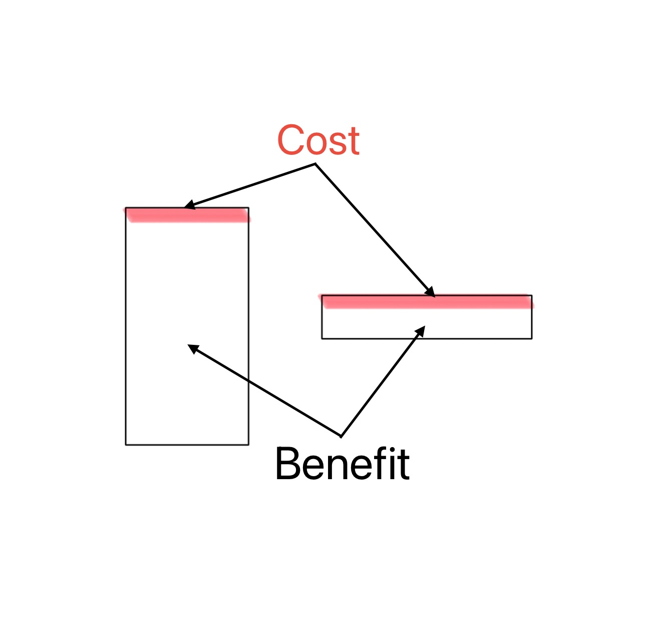
Deep modules
The complexity cost of a module is its interface.
The benefit of a module is its functionality.
The best modules are those with the greatest benefit and least cost.

Slide 23
Deep modules: Example Linux I/O
int open(const char *pathname, int flags, mode_t mode);
ssize_t read(int fd, void buf, size_t count);
ssize_t write(int fd, const void buf, size_t count);
off_t lseek(int fd, off_t offset, int whence);
int close(int fd);
How are files represented on disk to allow for efficient access?
How are directories stored, and how are hierarchical path names processed to find the files they refer to?
How are permissions enforced?
How are file accesses implemented?
How is concurrent access implemented?
How are recent files cached in memory?
How can a variety of storage devices be incorporated into a single file system?
...

Slide 24
Shallow modules
Example?

